Slide 1
STP Machathon 3.0 Summit
Transformers

Slide 2
Contents
Pipeline Overview
Processing & Segmentation
Character Recognition model
Conclusion

Slide 3
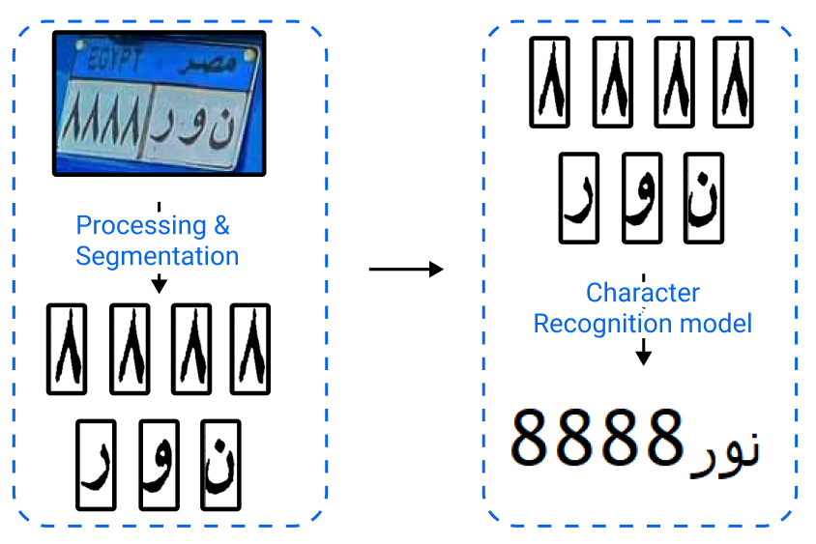
Pipeline Overview

Slide 4
Processing & Segmentation

Slide 5
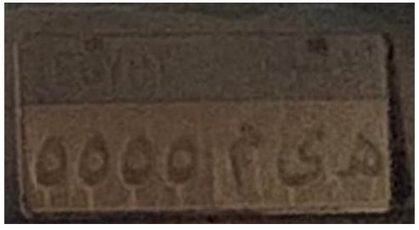
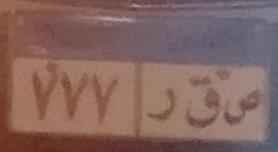
I- Processinng
Bad Illimination & Noise?
We used Morphological operations like to Maximize Contrast
Gaussian Blur to remove Noise

Slide 6
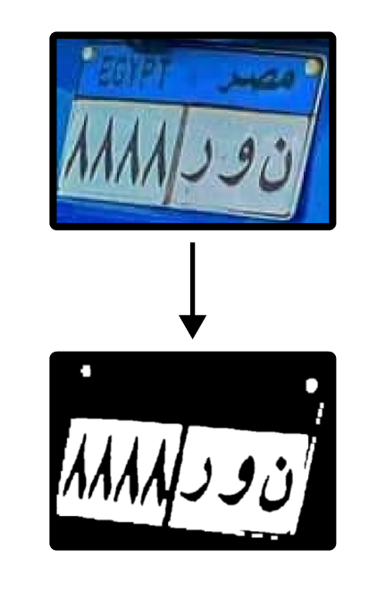
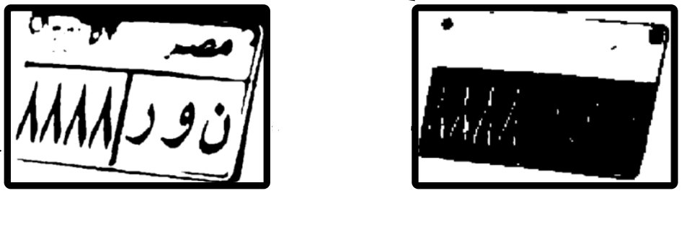
I- Processinng
Thresholding on both Value and Saturation channels.

Slide 7
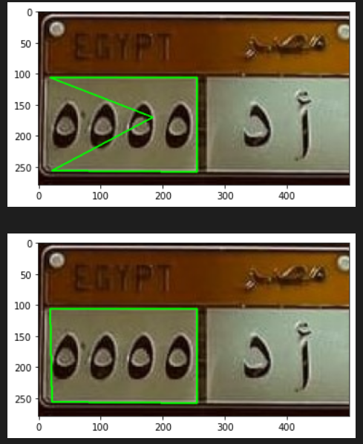
II - Contours
Noisy Contours?
Polygon Approximation
Concave polygons?
Convex hull
Difficult Camera angles?
4-Point transformation

Slide 8
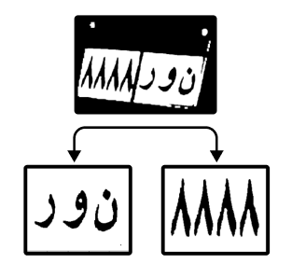
II – Contours (summary)
Sorted Contours Based on Area
Polygon Approximation
Convex hull for Concave polygons
4-Point transformation
We had 2 cases:
Contours already separated for numbers and letters
Big Countour containing both

Slide 9

III – Separating Characters
Use Contours to get symbols in white plate
Problem!
Arabic Letter may consist of multiple charachters e.g ت this may consist of 2/3 countours.

Slide 10
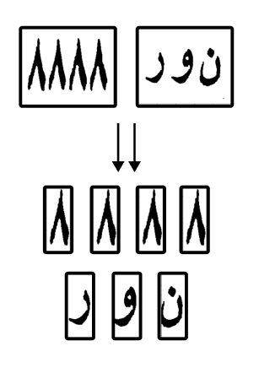
Solution: Sliding windows
Variable window width
Must have no black pixels on the sides
Must have a specific range of black pixels inside
For each group of windows the one with max black pixels is selected

Slide 11
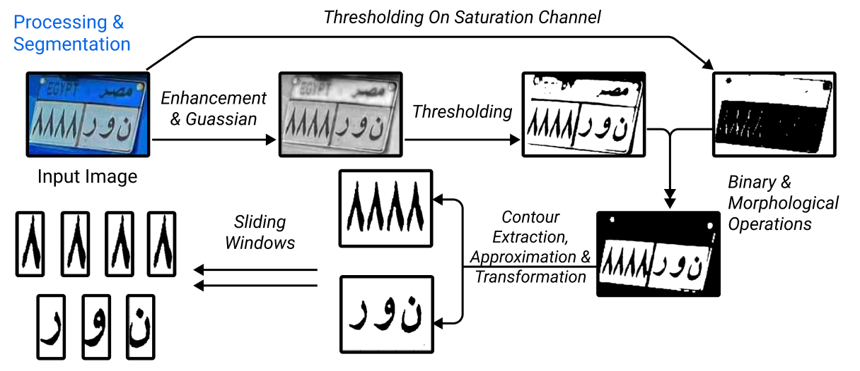
Summary

Slide 12
Character Recognition model

